Slide 1
Constraints in Entity-Relationship Models

Slide 2
Types of Constraints
Keys are attributes or sets of attributes that uniquely identify an entity within its entity set.
Single-value constraints require that a value be unique in certain contexts.
Referential integrity constrains require that a value referred to
actually exists in the database.
Domain constraints specify what set of values an attribute can take.
General constraints are arbitrary constraints that should hold in the database. We will study some examples in the second half of the semester.
Constraints are part of the schema of a database.

Slide 3
Keys
A key is a set of attributes for one entity set such that no two entities in this set agree on all the attributes of the key.
  It is allowed for two entities to agree on some, but not all, of the key attributes.
A key for an entity set E is a set K of one or more attributes such that given any two entities e1 and e2 in E, e1 and e2 cannot have identical values for all the attributes in K.
E can have multiple keys. We usually designate one as the primary key.
We must designate a key for every entity set.

Slide 4
Keys in E/R Diagrams
Underline the key attribute(s).
In an Isa hierarchy, only the root entity set has a key, and it must serve as the key for all entities in the hierarchy.
name
Drinks
manf
isa
Juices
Fruit

Slide 5
Example: a Multi-attribute Key
dept
number
hours
room
Courses
Note that hours and room could also serve as a
key, but we must select only one key.

Slide 6
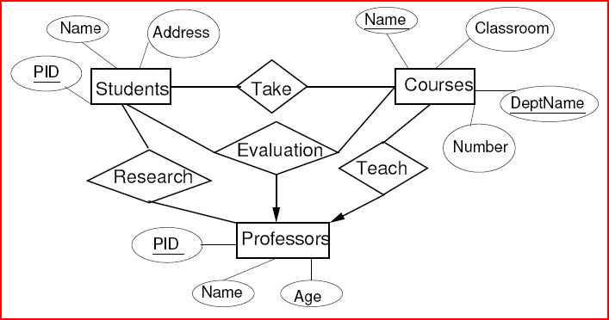
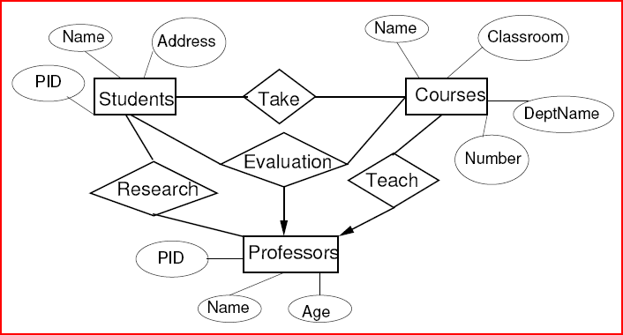
Examples of Keys

Slide 7
Single-Value Constraint
There is at most one value in a given context.
Each attribute of an entity set has a single value.
  If the value is missing, we can invent a “null” value.
  E/R models cannot represent the requirement that an attribute cannot have a null value.
A many-one relationship implies a single value constraint.

Slide 8
Referential Integrity Constraint
Asserts that exactly one value exists in a given context.
Usually used in the context of relationships.
Example: Many-one Advises relationship between Students and Professors.
  Many-one requirement says that no student may have more than one advising professor.
  Referential integrity constraint says that each student must have exactly one advising professor and that professor must be present in the database.
If R is a (many-to-one or one-to-one) relationship from E to F, we use a rounded arrowhead pointing to F to indicate that we require that the entity in F related by R to an entity in E must exist.

Slide 9
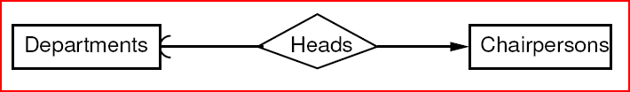
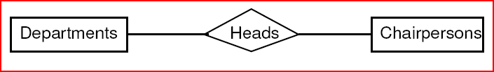
Example
Each department has at most one chairperson who is its head (there are times when a department may not have a chairperson).
Each chairperson can be the head of at most one department and this department must exist in the database.
Where do we put the arrows?

Slide 10

Enforcing Referential Integrity Constraints
We forbid the deletion of a referenced entity (e.g., a professor) until the professor advises no students.
We require that if we delete a referenced entity, we delete all entities that reference it.
When we insert a student entity, we must specify an existing professor entity connected to the student by the Advises relationship.

Slide 11
Weak Entity Sets
Occasionally, entities of an entity set need “help” to identify them uniquely.
Entity set E is said to be weak if in order to identify entities of E uniquely, we need to follow one or more many-one relationships from E and include the key of the related entities from the connected entity sets.

Slide 12
Example
name is almost a key for football players, but there might be two with the same name.
number is certainly not a key, since players on two teams could have the same number.
But number, together with the Team related to the player by Plays-on should be unique.
name
number
name
Players
Plays-
on
Teams
Double diamond for supporting many-one relationship.
Double rectangle for the weak entity set.

Slide 13
Weak Entity-Set Rules
A weak entity set has one or more many-one relationships to other (supporting) entity sets.
  Not every many-one relationship from a weak entity set need be supporting.
The key for a weak entity set is its own underlined attributes and the keys for the supporting entity sets.
  E.g., player-number and team-name is a key for Players in the previous example.

Slide 14
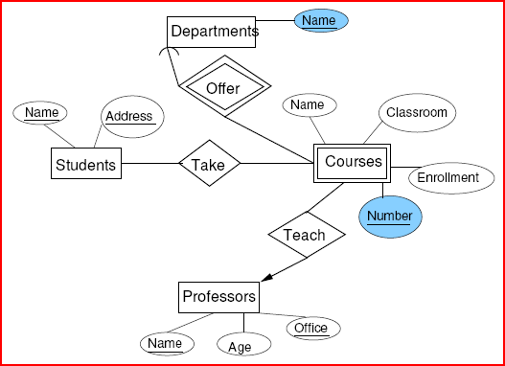
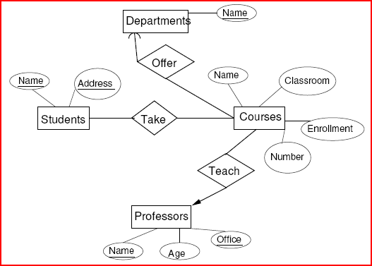
Example of Weak Entity Set
Each department teaches multiple courses. Each course has a number. What is the key for the entity set Courses?

Slide 15
Design Techniques
Be faithful to the specification of the application.
Avoid redundancy.
Keep the entities and relationship simple.
  Don’t use an entity set when an attribute will do.
Select the right relationships.
Select the right type of element.
Limit the use of weak entity sets.

Slide 16
Be Faithful
Do not use meaningless or unecessary attributes.
Define the multiplicity of a relationship appropriately.
  What is the multiplicity of the relationship Take between Students and Courses?
  What is the multiplicity of the relationship Teach between Professors and Courses?

Slide 17
Avoiding Redundancy
Redundancy occurs when we say the same thing in two different ways.
Redundancy wastes space and (more importantly) encourages inconsistency.
  The two instances of the same fact may become inconsistent if we change one and forget to change the other, related version.

Slide 18
Example: Bad
name
name
addr
ManfBy
Drinks
Manfs
manf
This design states the manufacturer of a Drink twice: as an attribute and as a related entity.

Slide 19
Example: Bad
name
manf
manfAddr
Drinks
This design repeats the manufacturer’s address once for each Drink; loses the address if there are temporarily no Drinks for a manufacturer.

Slide 20
Example: Good
name
name
addr
ManfBy
Drinks
Manfs
This design gives the address of each manufacturer exactly once.

Slide 21
Entity Sets Versus Attributes
An entity set should satisfy at least one of the following conditions:
  It is more than the name of something; it has at least one nonkey attribute.
  or
  It is the “many” in a many-one or many-many relationship.

Slide 22
Example: Good
name
name
addr
ManfBy
Drinks
Manfs
Manfs deserves to be an entity set because of the nonkey attribute addr.
Drinks deserves to be an entity set because it is the “many” of the many-one relationship ManfBy.

Slide 23
Example: Bad
name
name
ManfBy
Drinks
Manfs
Since the manufacturer is nothing but a name, and is not at the “many” end of any relationship, it should not be an entity set.

Slide 24
Example: Good
name
manf
Drinks
There is no need to make the manufacturer an entity set, because we record nothing about manufacturers besides their name.

Slide 25
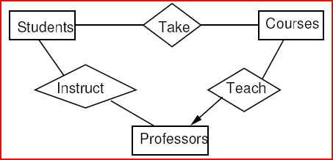
Design
Do not add unnecessary relationships.
It may be possible to deduce one relationship from another.
Do we need the relationship Instruct between Professors and Students?
  No. We can deduce this relationship from Take and Teach.

Slide 26
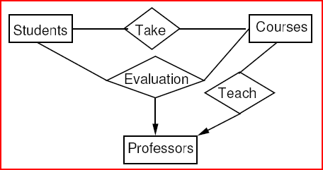
Design
Do not add unnecessary relationships.
It may be possible to deduce one relationship from another.
Do we need the relationships Take and Teach?
  Yes. Why?

Slide 27
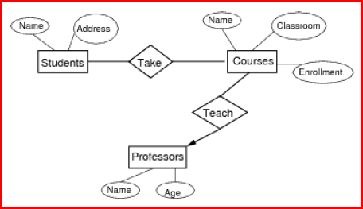
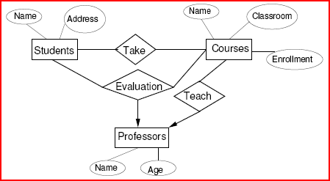
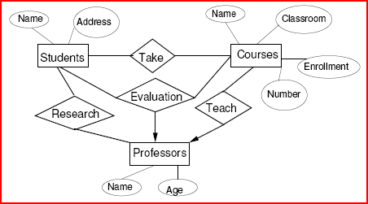
Select the Right Type of Element
Attribute or Entity or Relationship?
Can we make Professor an attribute of Courses and remove the relationship Teach?
What if we add the relationship Evaluation?
What if we add the relationship Research signifying a research project the student is working on with a professor?

Slide 28
Converting an Entity Set into an Attribute
If an entity set E satisfies the following properties:
  All relationships involving E have arrows entering E.
  The attributes of E collectively identify an entity (i.e., no attribute depends on another).
  No relationship involves E more than once
then we can replace E as follows:
  If there is a many-one relationship R from an entity set F to E, remove R and make the attributes of E be attributes of F.
  If there is a multi-way relationship R with an arrow to E, make the attributes of E be new attributes of R and remove the arrow from R to E.

Slide 29
Don’t Overuse Weak Entity Sets
Beginning database designers often doubt that anything could be a key by itself.
  They make all entity sets weak, supported by all other entity sets to which they are linked.
In reality, we usually create unique ID’s for entity sets.
  Examples include social-security numbers, automobile VIN’s etc.

Slide 30
When Do We Need Weak Entity Sets?
The usual reason is that there is no global authority capable of creating unique ID’s.
Example: it is unlikely that there could be an agreement to assign unique player numbers across all football teams in the world.

Slide 31
Binary vs. Non-Binary Relationships
Some relationships that appear to be non-binary may be better represented using binary relationships
  E.g. A ternary relationship parents, relating a child to his/her father and mother, is best replaced by two binary relationships, father and mother
    Using two binary relationships allows partial information (e.g. only mother being known)
  But there are some relationships that are naturally non-binary
    Example: works_on

Slide 32
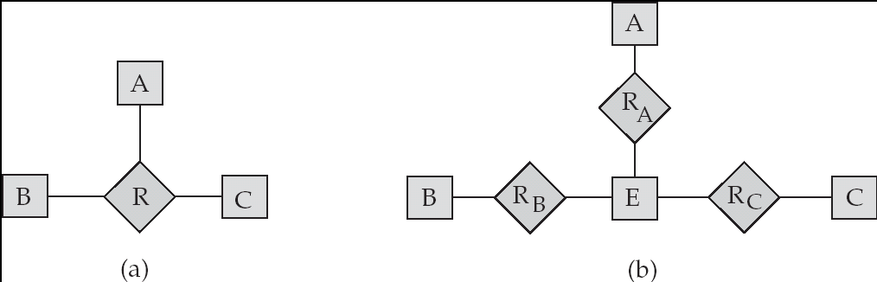
Converting Non-Binary Relationships to Binary Form
In general, any non-binary relationship can be represented using binary relationships by creating an artificial entity set.
  Replace R between entity sets A, B and C by an entity set E, and three relationship sets:
1. R_{A}, relating E and A 2.R_{B}, relating E and B
3. R_{C}, relating E and C
  Create a special identifying attribute for E
  Add any attributes of R to E
  For each relationship (a_{i} , b_{i} , c_{i}) in R, create
1. a new entity e_{i} in the entity set E 2. add (e_{i} , a_{i} ) to R_{A}
3. add (e_{i} , b_{i} ) to R_{B} 4. add (e_{i} , c_{i} ) to R_{C}

Slide 33
End of E/R Diagrams

